Slide 1
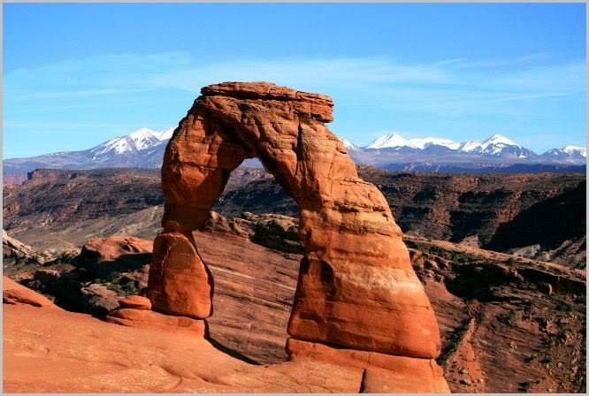
Sedimentary Rocks

Slide 2
2 Items to Turn In
Part I: Questions on Sedimentary Rocks
Types of Weathering
Definitions of Grain Sizes (Pebble should be replaced with Gravel)
Part II: Sedimentary Rocks Chart
Sedimentary Rocks Identification
Depositional Environments
Heads-Up for Next Week: Metamorphic Rocks but will include component on igneous, sedimentary, and metamorphic rocks.

Slide 3
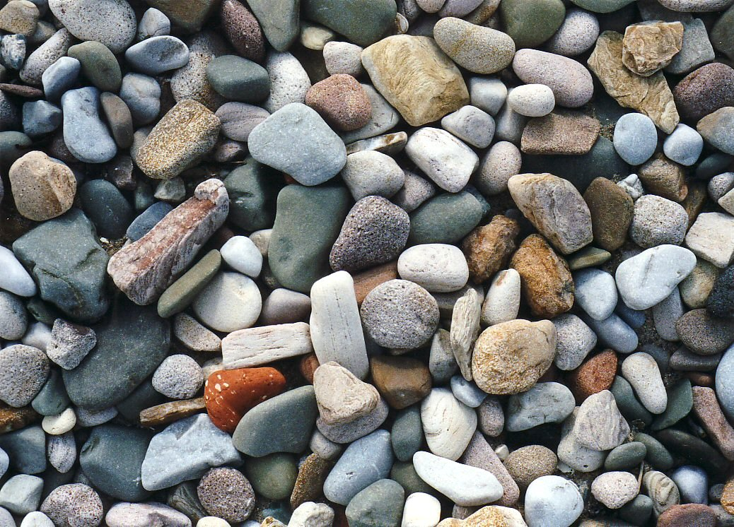
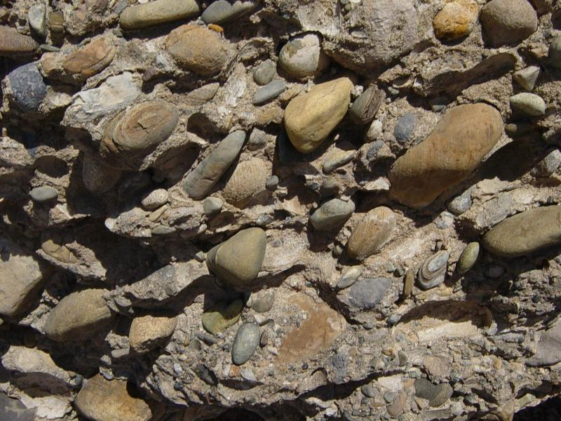
What are sediments?
What are sedimentary rocks?
Includes rock fragments, mineral grains, parts of plants and animals, rust
Sediments are the product of weathered source materials
Form from loose fragments of sediments produced by weathering of older rock
Can form from igneous, metamorphic, and/or other sedimentary rocks

Slide 4
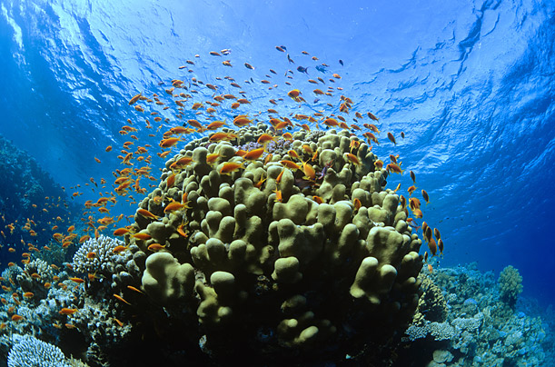
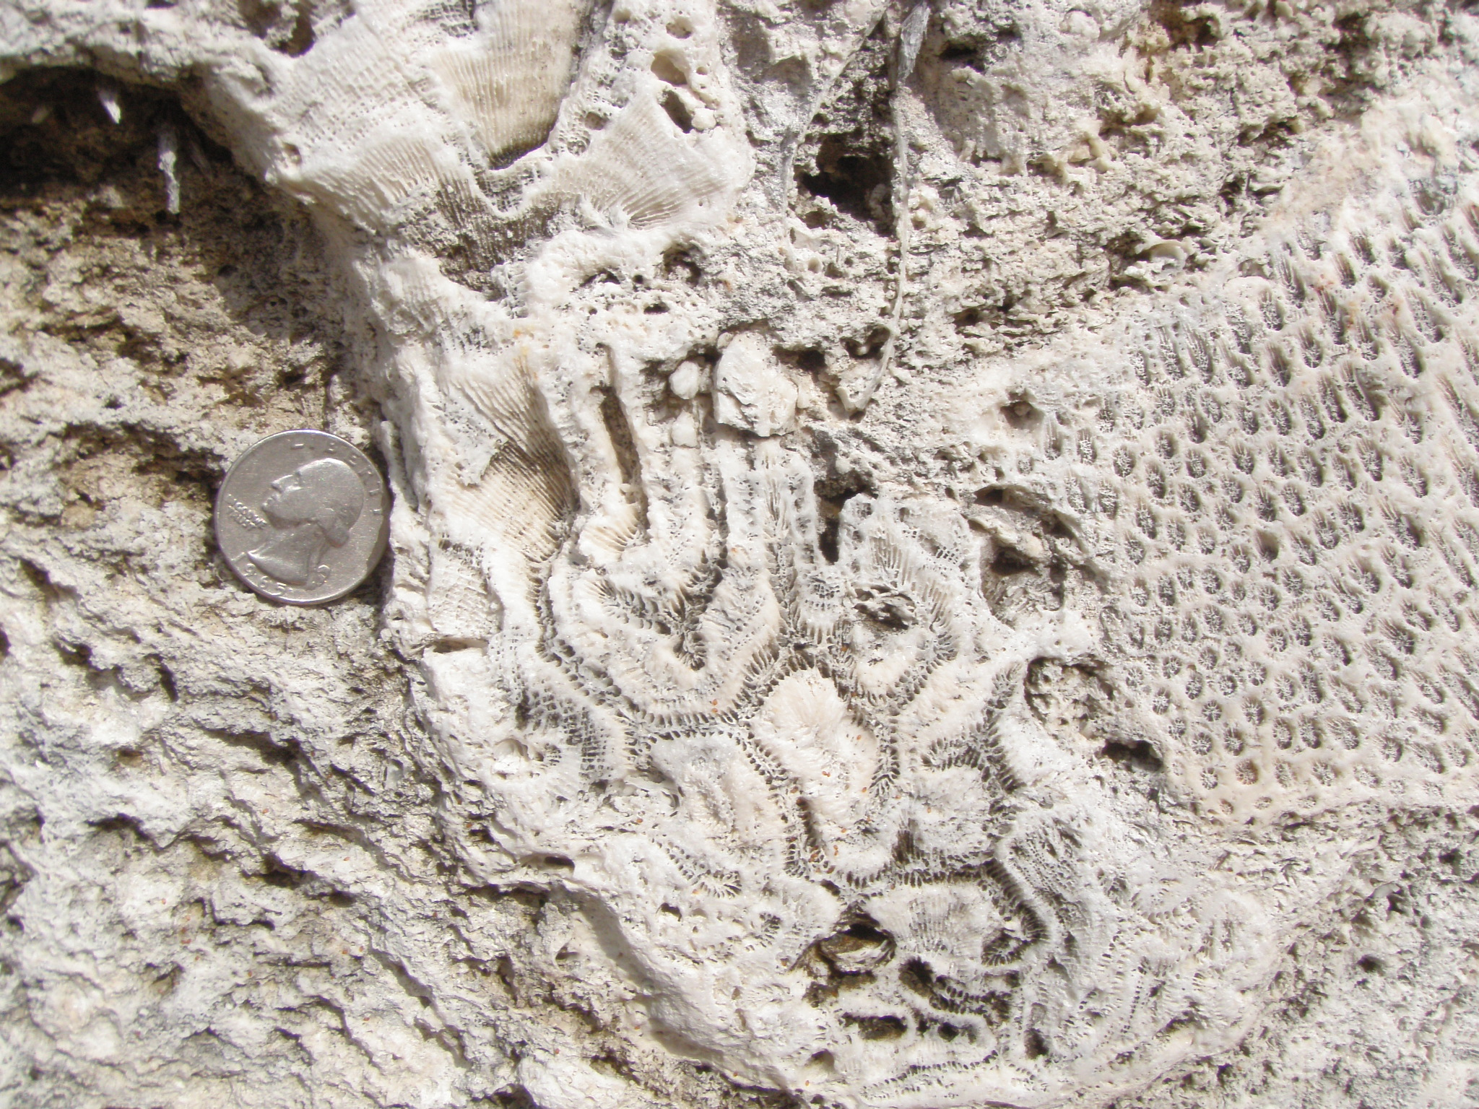
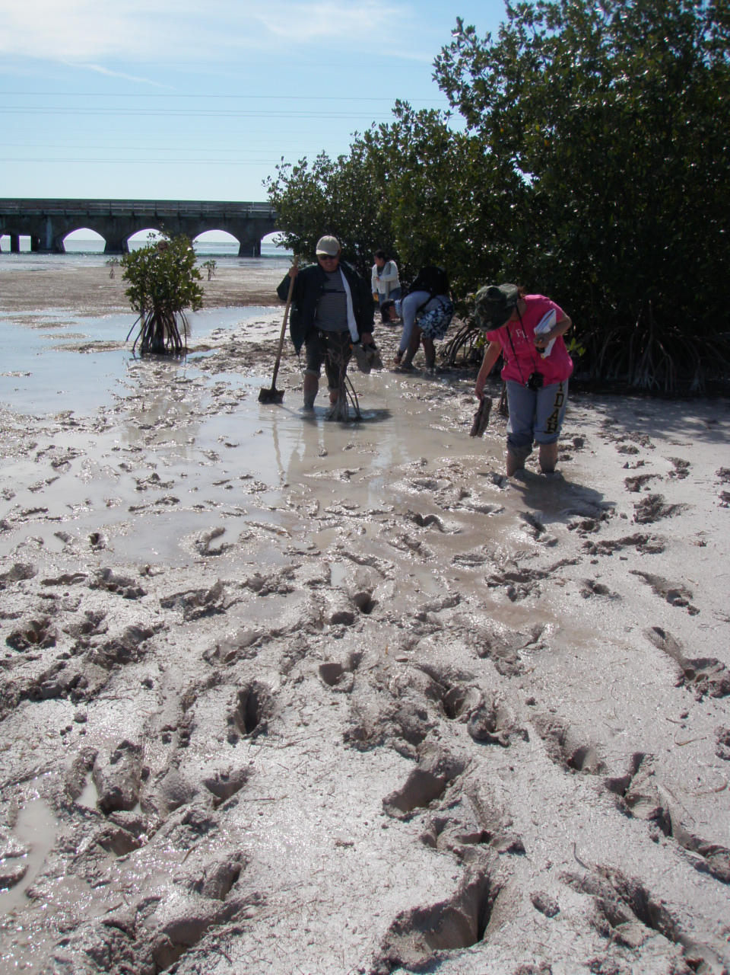
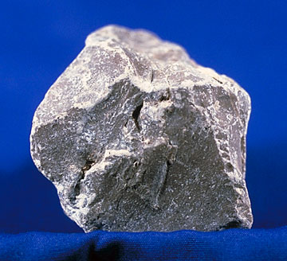
What can they tell us?
Identifying sedimentary rocks can help you understand the history and depositional environment of the rock.

Slide 5
How do we identify our rocks?
Grain Size – clay, silt, sand, gravel
Grain Shape – very angular to well rounded
Grain Sorting – poorly sorted to well sorted
Crystalline texture/Micro-crystalline texture

Slide 6
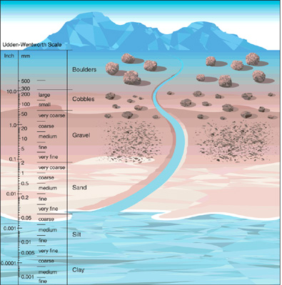

Slide 7
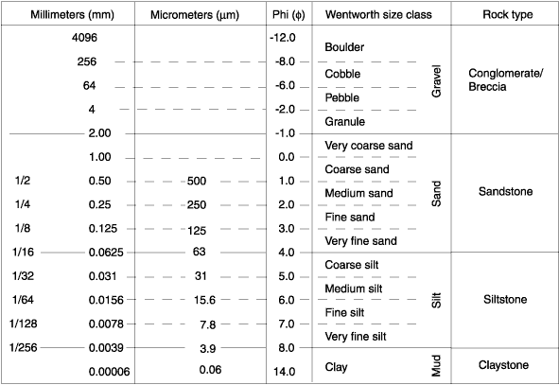
Udden-Wentworth Grain Sizes

Slide 8
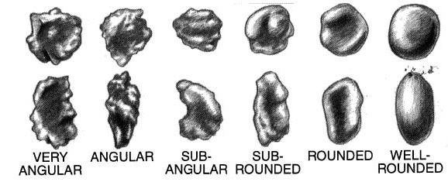
Increase Weathering

Slide 9
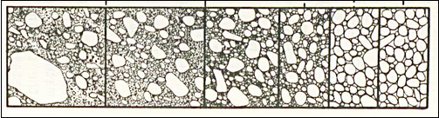
Very poorly sorted | Poorly sorted | Moderately sorted | Well sorted | Very well sorted
Increase Transport Distance

Slide 10
Quick Quiz
As a class; look at rock #1
What are the grain sizes?
What are the grain shapes?
What is the sorting?
Possible depositional environments?

Slide 11
Quick Quiz
As a class; look at rock #3
What are the grain sizes?
What are the grain shapes?
What is the sorting?
Possible depositional environments?

Slide 12
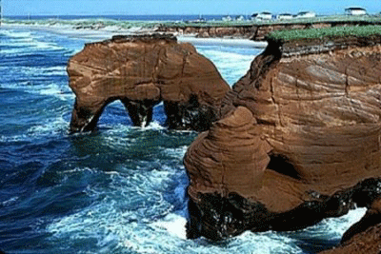
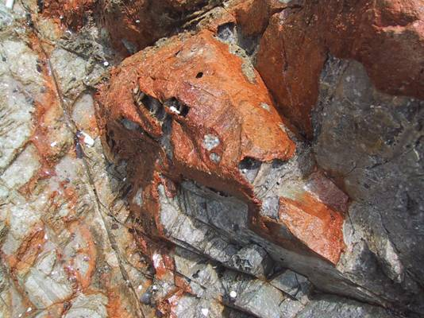
Two Types of Weathering
Physical
Chemical
Breaking of a rock by force
Rock is changed by reacting with a chemical

Slide 13
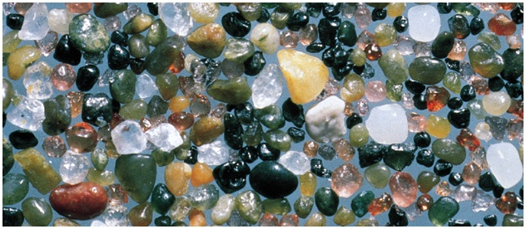
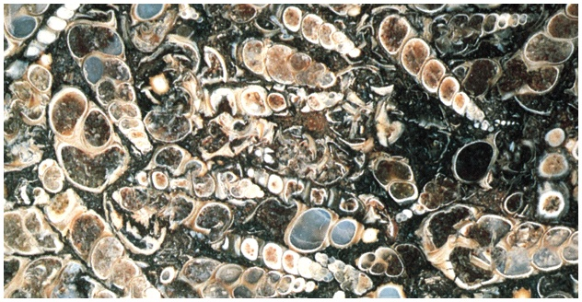
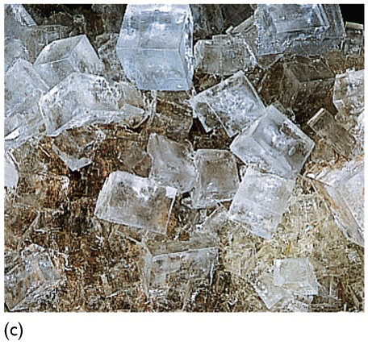
Sedimentary Composition
Detrital (Siliciclastic): Minerals and rock fragments. Examples include conglomerate, breccia, sandstone, and shale, and are named according to the grain size of the sediment particles.
Biochemical (Bioclastic): Remains or fragments of organisms (shells, animals, plants). Example includes limestone composed of shell fragments or similar organic remains. Fragments may be large and visible or small and microscopic.
Chemical (Nonclastic): Crystals that precipitate from water. Examples include limestone and chert, and are named according to the mineral present.

Slide 14
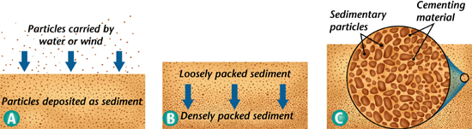
Cementation
Sediment is deposited
Sediment is hardened/compacted (lithification)
Sediment is cemented by dissolved minerals

Slide 15
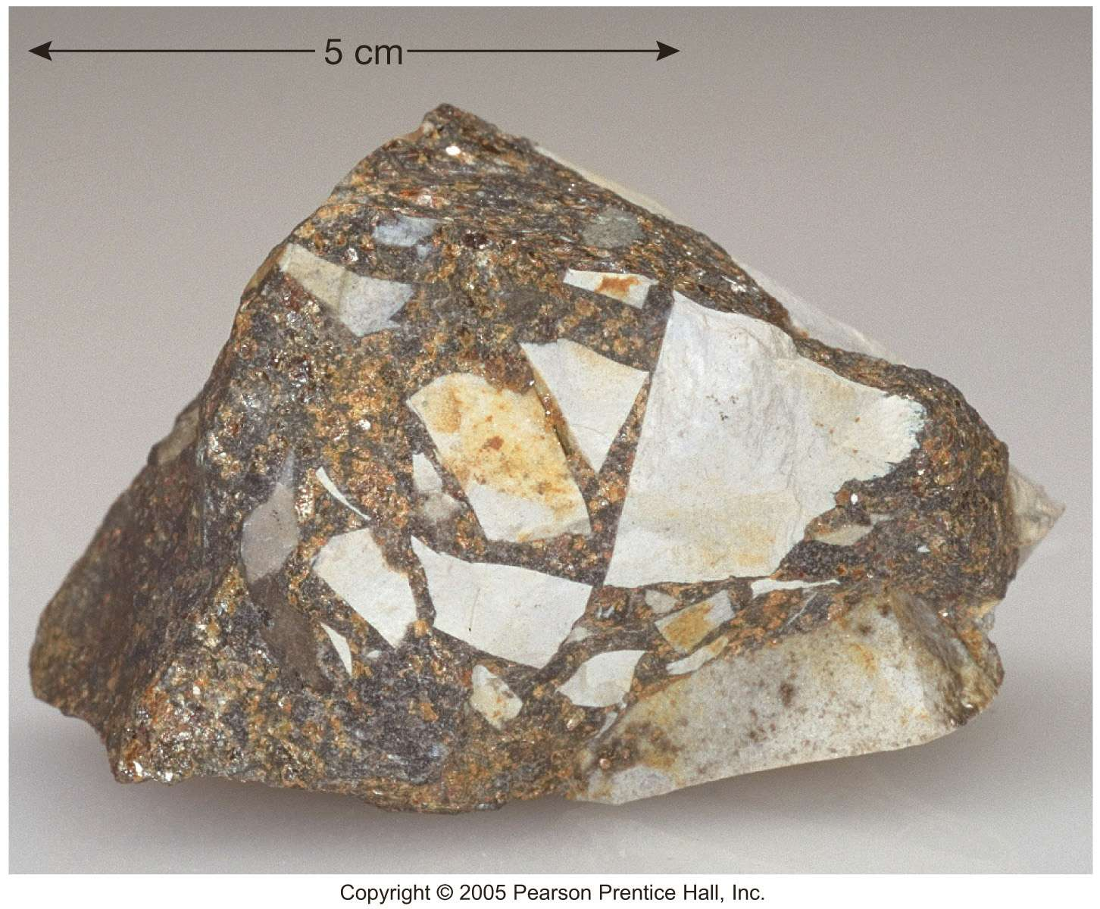
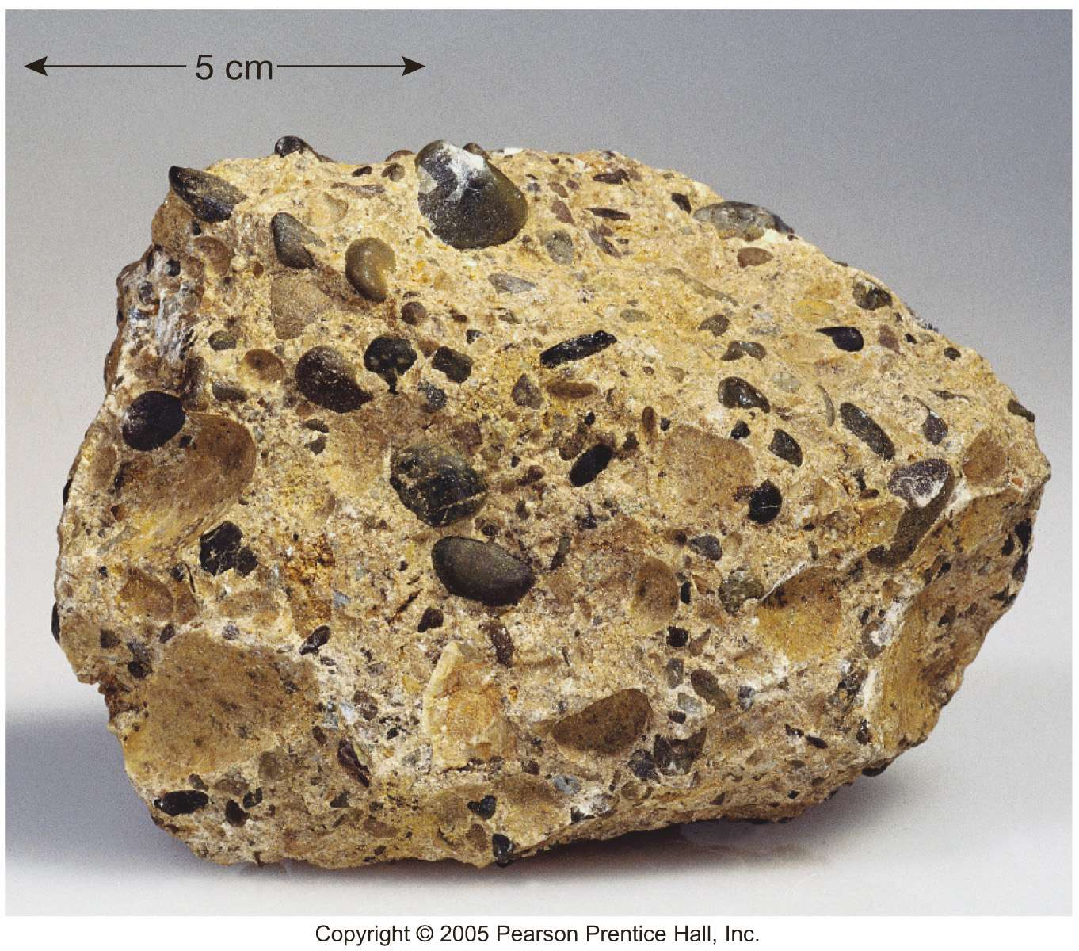
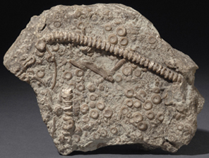
Suggested Order
Sedimentary Rock Identification
Column 2: Classification as Detrital, Biochemical, or Chemical
Column 3: Classification by Grain Size, Grain Shape, and Minerals Present (or sorting)
Column 4: Color and Other Physical Properties (presence or absence of shells, malleability, or reaction to HCL)
Column 1: Rock Name
Depositional Environments
Column 5: Identify possible depositional environments for the identified sedimentary rocks

Slide 16
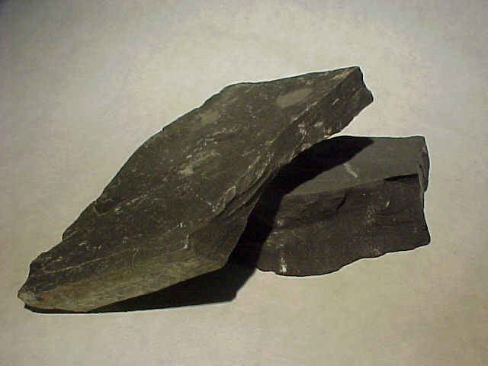
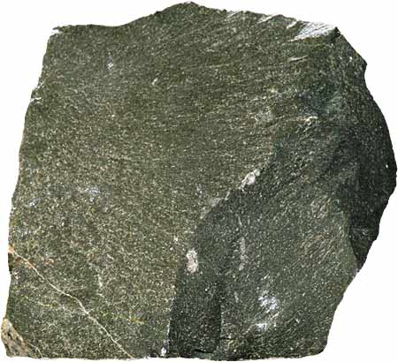
Suggested Depositional Environments
Depositional Environments
Use the following list to complete the Depositional Environment column
Base of mountain
Reef
Ooid shoal
Alluvial fan
Beach
Mountains
Marine
Continental slope
Swamp
Deep ocean
Marsh
River bed
Deep marine
Desert
More than 1 Depositional Environment may be applicable to some of the rock samples.

